Slide 1
Eugenics Today: Hospitals and Care Facilities are Federally Mandated Killing Fields

Slide 2
Grace is the reason I’m here…

Slide 3
Medical Records Tell Quite A Story

Slide 4
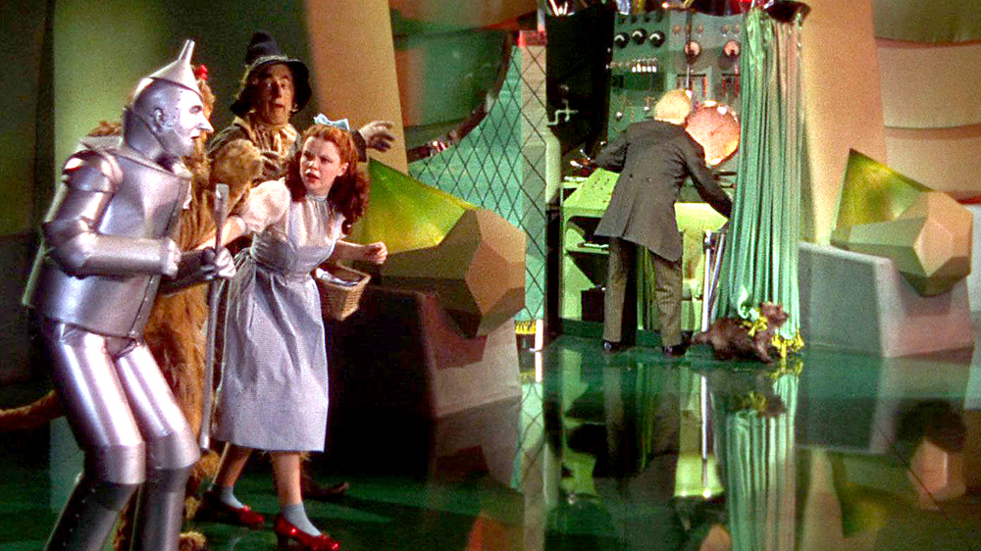
Let’s find out who’s behind the curtain…

Slide 5
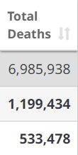
Numbers Don’t Lie – USA is #1 Covid Hospital Deaths, Worldwide
Worldwide deaths 6,985,938
USA has 4.2% of world’s population
and 17.2% of world’s deaths
India’s population is 428% of USA
and land mass is 36% of USA
Source 2/25/24: https://www.worldometers.info/coronavirus/#countries

Slide 6
God warned us that America will lead the world astray
Revelation 18:23:
For your merchants were the most important people of the earth, because with your pharmakeia they deceived all the nations.

Slide 7
Medicare/Medicaid costs set up the collectivism lie
The system’s diagnosis - “The financial projections in this report indicate a need for substantial changes to address Medicare’s financial challenges.” https://www.cms.gov/files/document/2021-medicare-trustees-report.pdf (page 11).
Think this through: Medicare/Medicaid is the ultimate bait and switch – we payroll deduct so we have “free health care” when we retire; remember, we paid for this ‘privilege’ our entire working life, but it is wrapped up in bow looking like our government is taking care of the elderly and the disabled. Then, they program us to bow down to the doctor and they license the doctor, so he won’t be paid unless he follows CMS Standards of Care designed to hasten our deaths.
CMS says 135M on program: https://www.cms.gov/newsroom/news-alert/cms-releases-latest-enrollment-figures-medicare-medicaid-and-childrens-health-insurance-program-chip
Over 50% of the annual federal budget is related to these bureaucracies!

Slide 8
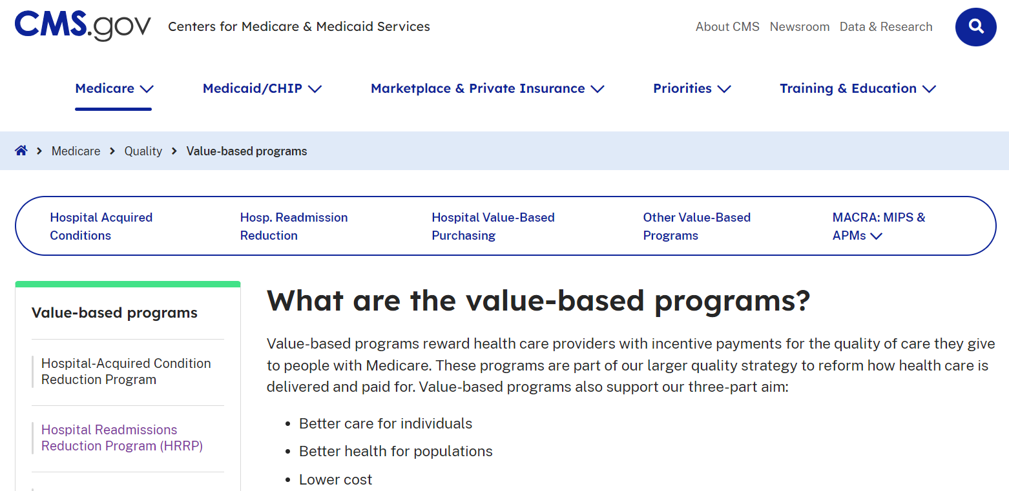
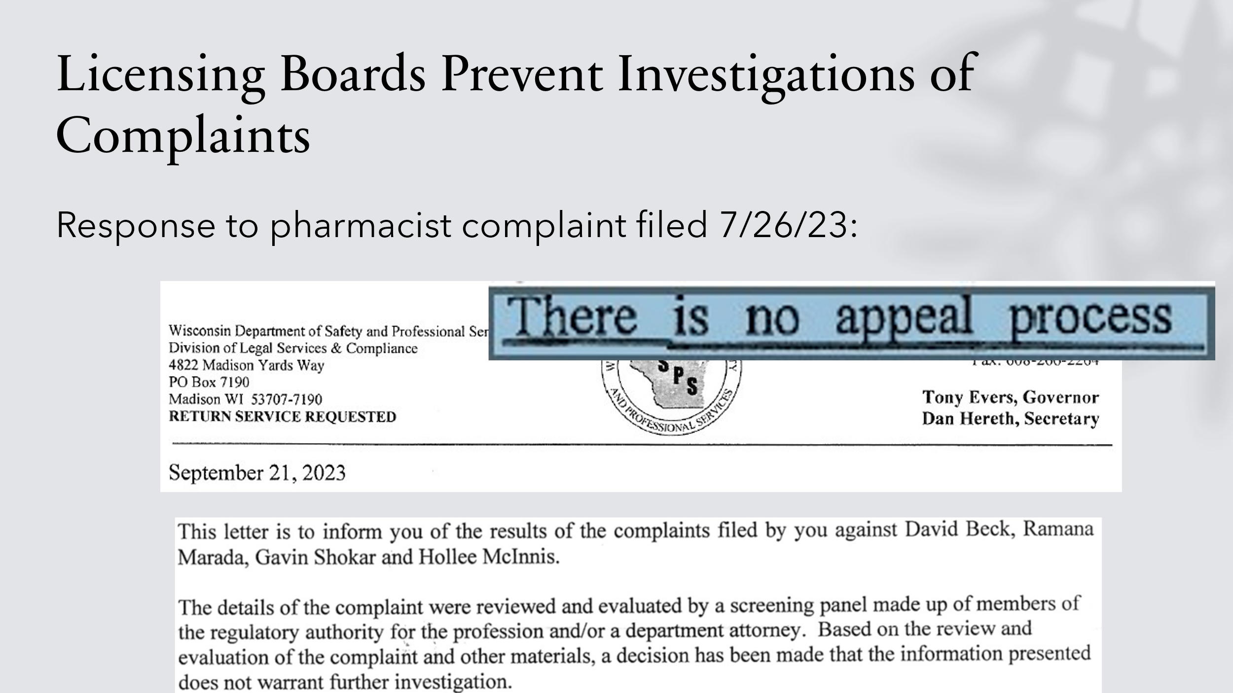
CMS Writes All The Standards of “Care”

Slide 9
Cancer Standard of “Care” = 2.1% Survival

Slide 10
State Licensing Board Authorizes Illegal DNRs

Slide 11
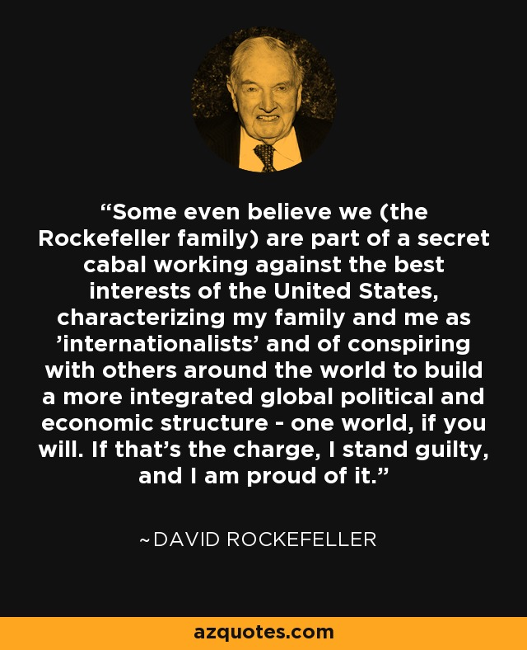

Slide 12
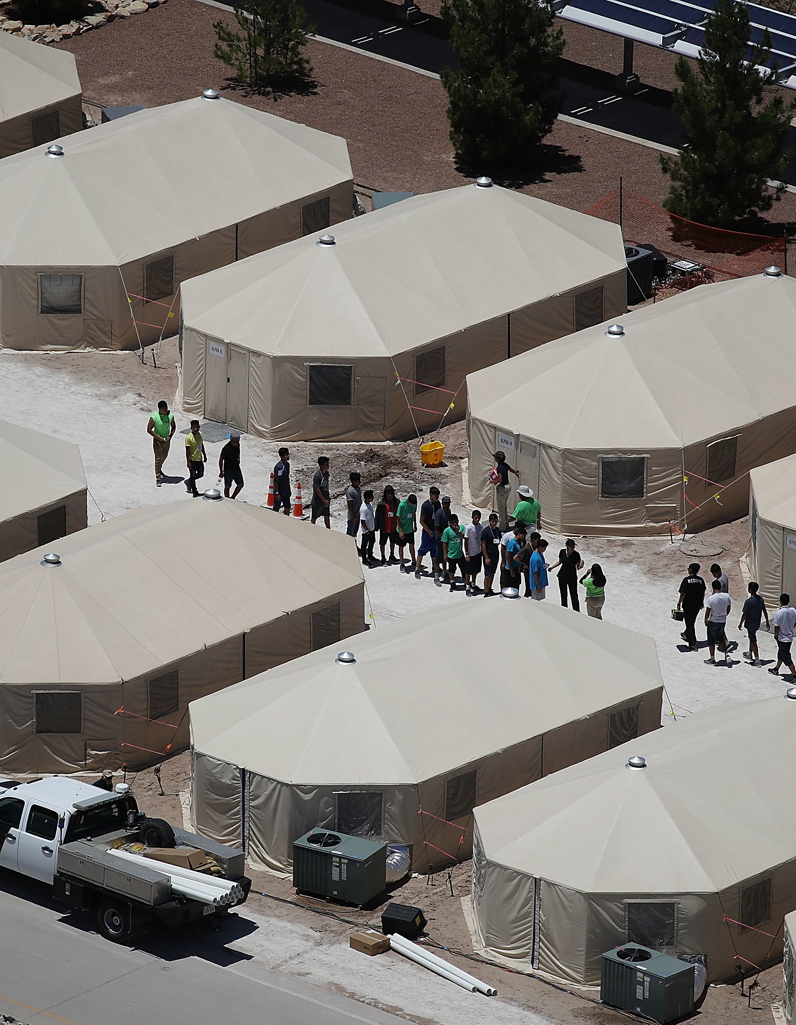
One reason: FEMA Training for Pastors
Began in 2006
“Pastors were asked to make a pledge or an affirmation during the meeting to fulfill the roles ascribed to them by FEMA. They were given assurances that they would be covered by full compensation in the event of resisters injuring them during property seizures and round-ups”
28,000-100,000 pastors were recruited by FEMA/DHS as part of Clergy Response Team
Similar to the role of churches under the Nazi regime
“These discussions, however, tended to become focused more on secondary strategic considerations – like maintaining good relations with colleagues in the German Churches – than on the central humanitarian issues that were really at stake”
“Sing a little louder” is a testimony shared by a German Jew who watched from his place of worship each week trains carrying Jews into a concentration camp
Diedrich Bonhoeffer – “Not to speak is to speak; not to act is to act.”

Slide 13
Revelation 12:9: “And the great dragon was cast out, that old serpent, called the Devil, and Satan, which deceiveth the whole world: he was cast out into the earth and his angels were cast out with him.”

Slide 14
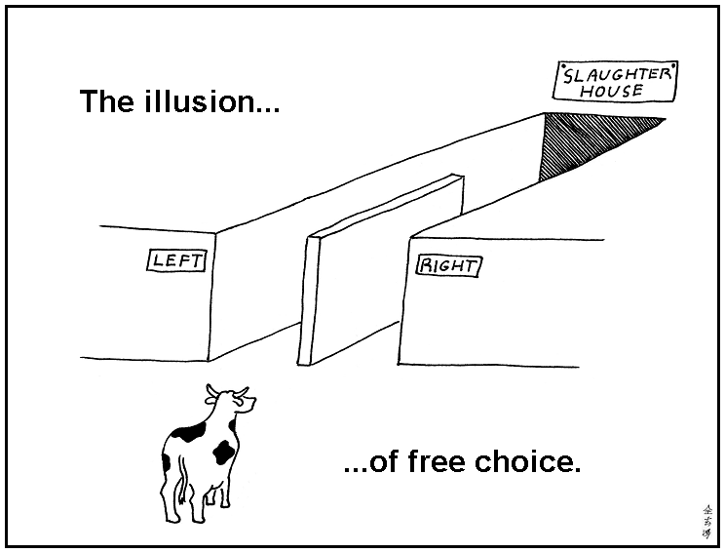
2 Thessalonians 2:10-12: They perish because they refused to love the truth and so be saved. For this reason, God sends them a powerful delusion so that they will believe the lie and so that all will be condemned who have not believed the truth but have delighted in wickedness. Dialectics program us to believe we have a choice – news flash…Satan controls both sides
Hastening our deaths is murder
God’s way is always outside these programmed choices leading to the death funnel
How did we get here? Rejecting God
What’s missing? Repentance

Slide 15
Please visit: OurAmazingGrace.net

Slide 16
